Slide 1
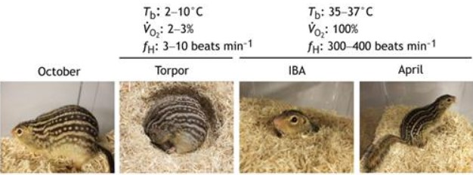
Hibernation and Metabolic in Ground Squirrels Through Mass Spectrometry Analysis and R Data Visualization
Image adapted from Andrews M. T. (2019).
The data, sourced from Dr. Matt Andrews' laboratory, spans months critical to hibernation.
The analysis focuses on the role of brown adipose tissue and its associated metabolites, and what could be the specific metabolites and pathways activated during hibernation.

Slide 2
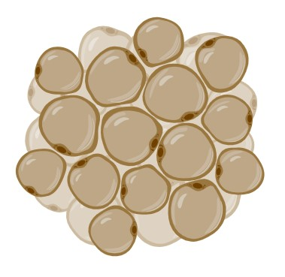
Objectives
The focus is on data analysis and visualization. Using Mass Spectrometry (MS) data collected over several months, by using R for data visualization and comprehensive metabolomics analysis.
I will examine the metabolite profiles during different periods (September to March), The goal is to identify key metabolites and metabolic pathways activated during hibernation.
Image adapted from Biorender

